Slide 1

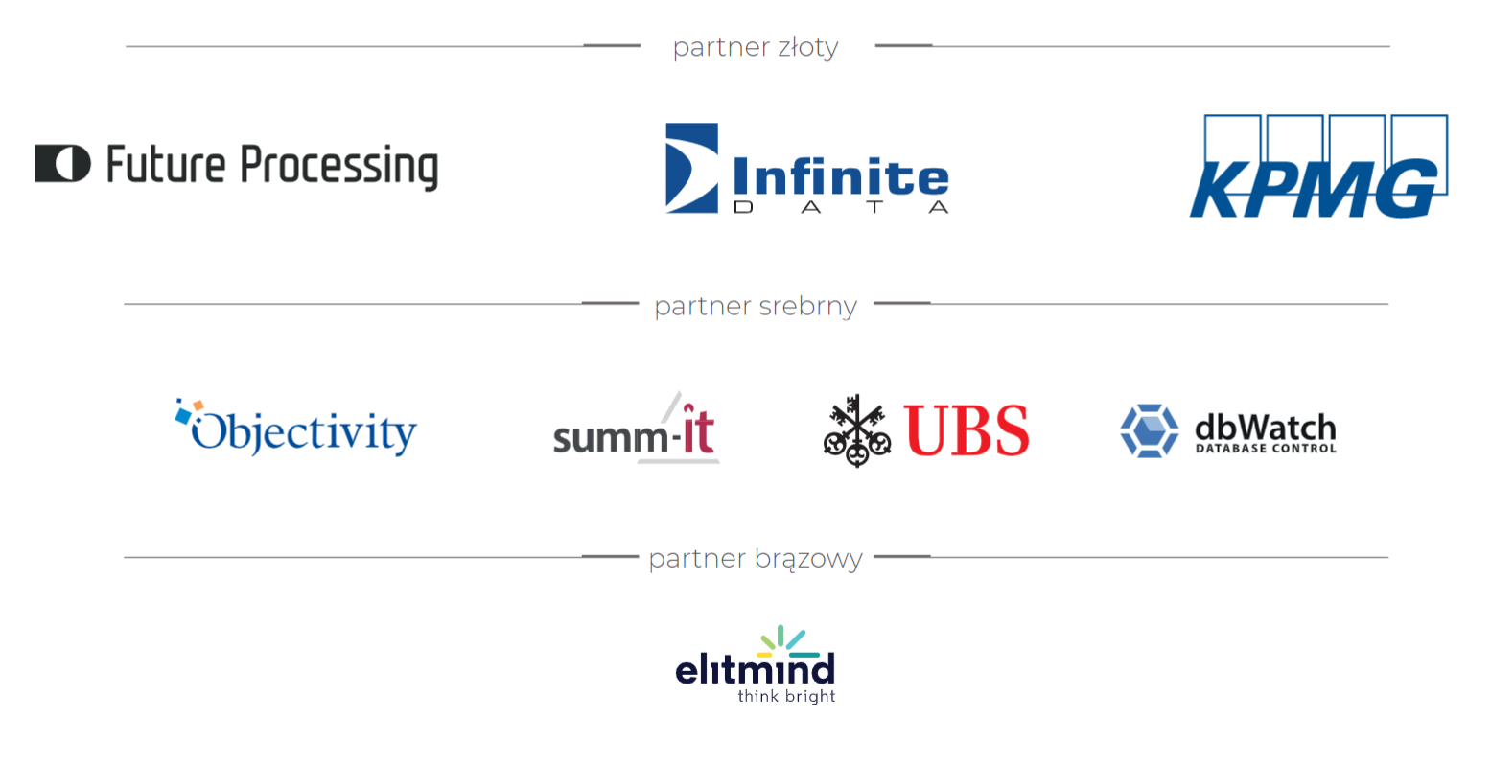

Slide 2
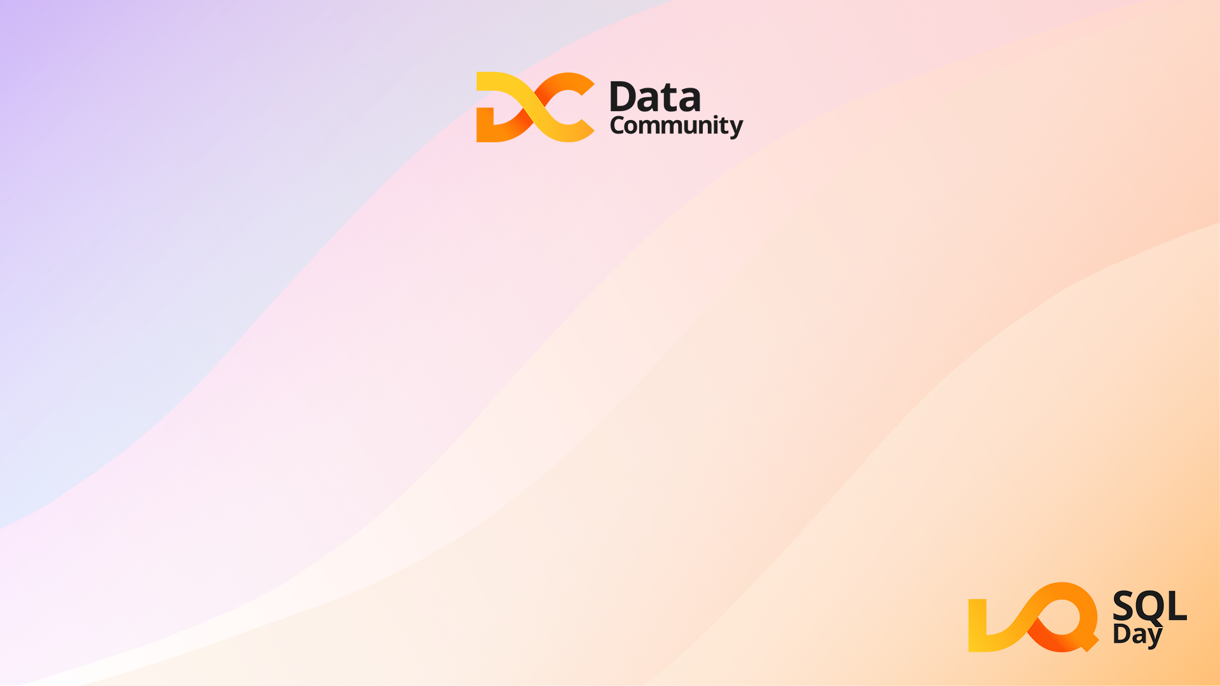
Praca z Azure SQL Managed Instance - przemyślenia prosto z chmury
Agnieszka Cieplak
Damian Widera

Slide 3

Agnieszka
Asseco Business Solutions
Community leader

Slide 4
Damian Widera
Team Leader – EUVIC
Microsoft MVP (2009)
Microsoft MCT (2005)
Data passionate

Slide 5
AGENDA
Wprowadzenie
Scenariusze
Limity
Features
Konfiguracja i administracja
Wydajność
Mechanizmy HA / DR
Co dalej – co wypróbować?

Slide 6
Wprowadzenie

Slide 7
SQL Server w Azure
Azure SQL Database – single / standalone database
Azure SQL Managed Instance – instance of the SQL Server that can have up to 100 databases and not managing the infostructure
SQL Server on Azure VMs

Slide 8
Azure SQL Database
Single / standalone database – “contained”
Means no access to other databases and system objects
No SQL Server Agent
No Service Broker
Provisioned (vCore or DTU model)
Every 100 DTUs Standard tier = 1 vCore of General Purpose.
Every 125 DTUs Premium = 1 vCore of Business Critical
Serverless

Slide 9
Azure SQL Database
Database size limits – 4TB
Hyperscale to 100 TB, but
This is one way ticket
Pooling – reserve compute resources and share among databases in one logical SQL Server

Slide 10
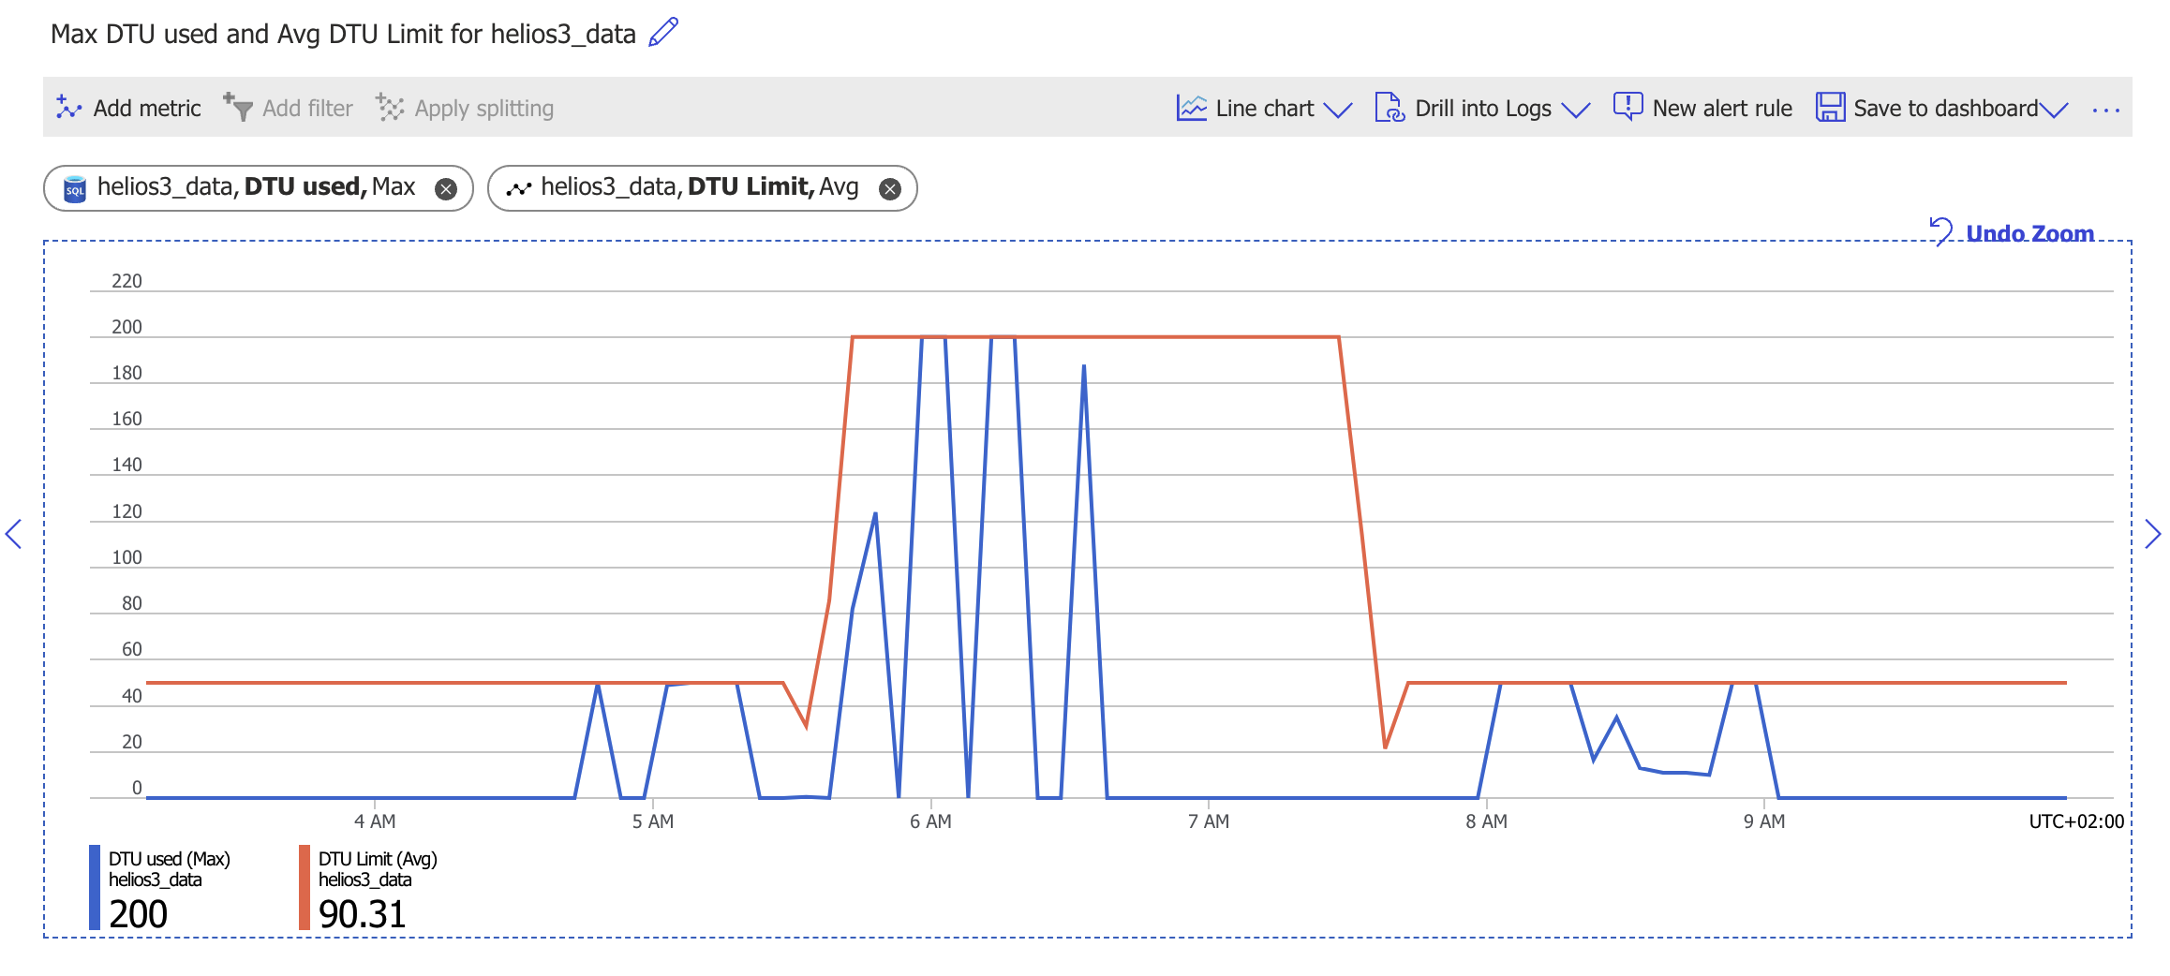
Azure SQL Database

Slide 11
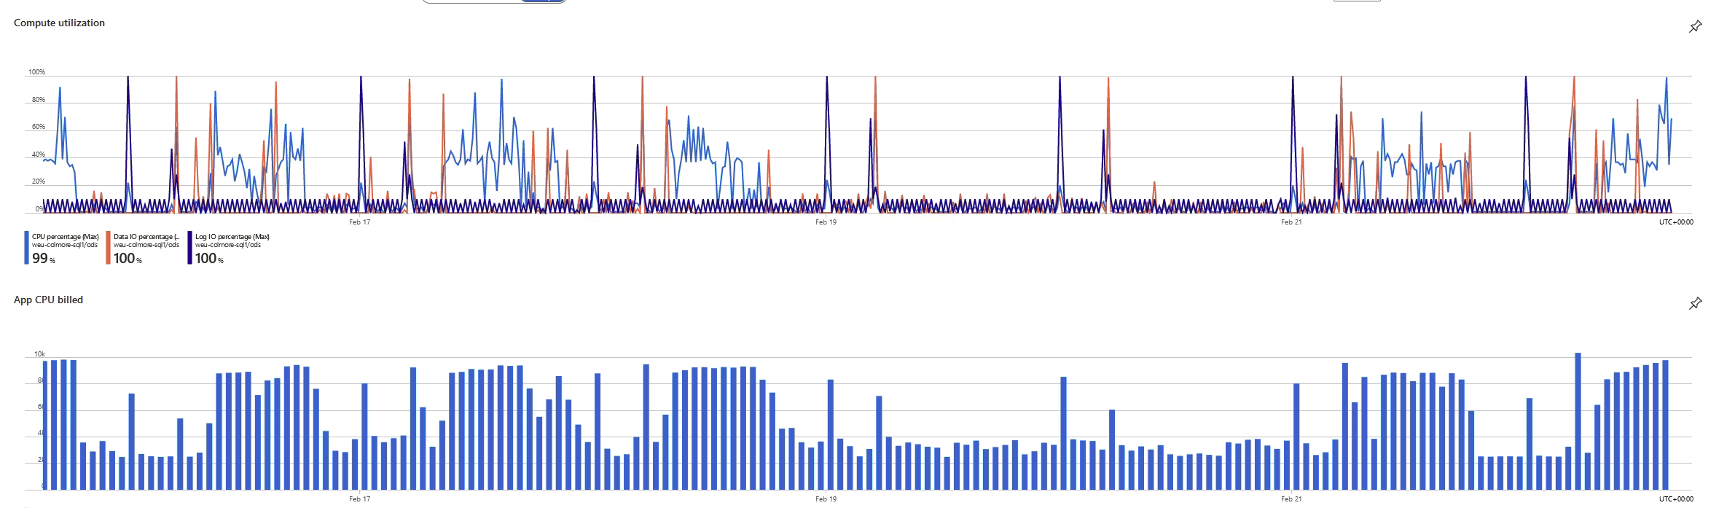
Azure SQL Database

Slide 12
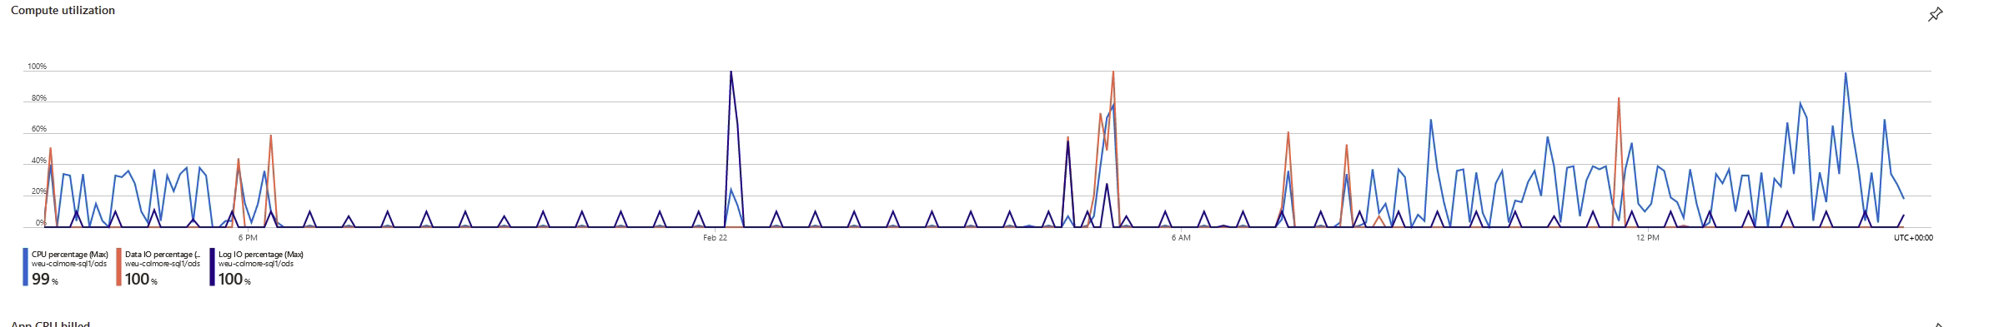
Azure SQL Database

Slide 13
Azure Managed Instance
SQL Managed Instance has near 100% compatibility with the latest SQL Server (Enterprise Edition) database engine
SQL Managed Instance allows existing SQL Server customers to lift and shift their on-premises applications to the cloud with minimal application and database changes.

Slide 14
Azure Managed Instance
SQL Managed Instance is available in two service tiers:
General purpose: Designed for applications with typical performance and I/O latency requirements.
Business critical: Designed for applications with low I/O latency requirements and minimal impact of underlying maintenance operations on the workload.
Both service tiers guarantee 99.99% availability and enable you to independently select storage size and compute capacity

Slide 15
Azure Managed Instance
General Purpose service tier
The following list describes key characteristics of the General Purpose service tier:
Designed for the majority of business applications with typical performance requirements
High-performance Azure Blob storage (16 TB)
Built-in HA based on reliable Azure Blob storage and Azure Service Fabric

Slide 16
Azure Managed Instance
Business Critical service tier
Designed for business applications with highest performance and HA requirements
Comes with super-fast local SSD storage (up to 4 TB on Standard Series (Gen5), up to 5.5 TB on Premium Series and up to 16 TB on Premium Series Memory-Optimized)
Built-in HA based on Always On AG and Azure Service Fabric
Built-in additional read only database replica that can be used for reporting and other read-only workloads
In-memory OLTP that can be used for workload with high-performance requirements

Slide 17
Features, czyli co działa

Slide 18
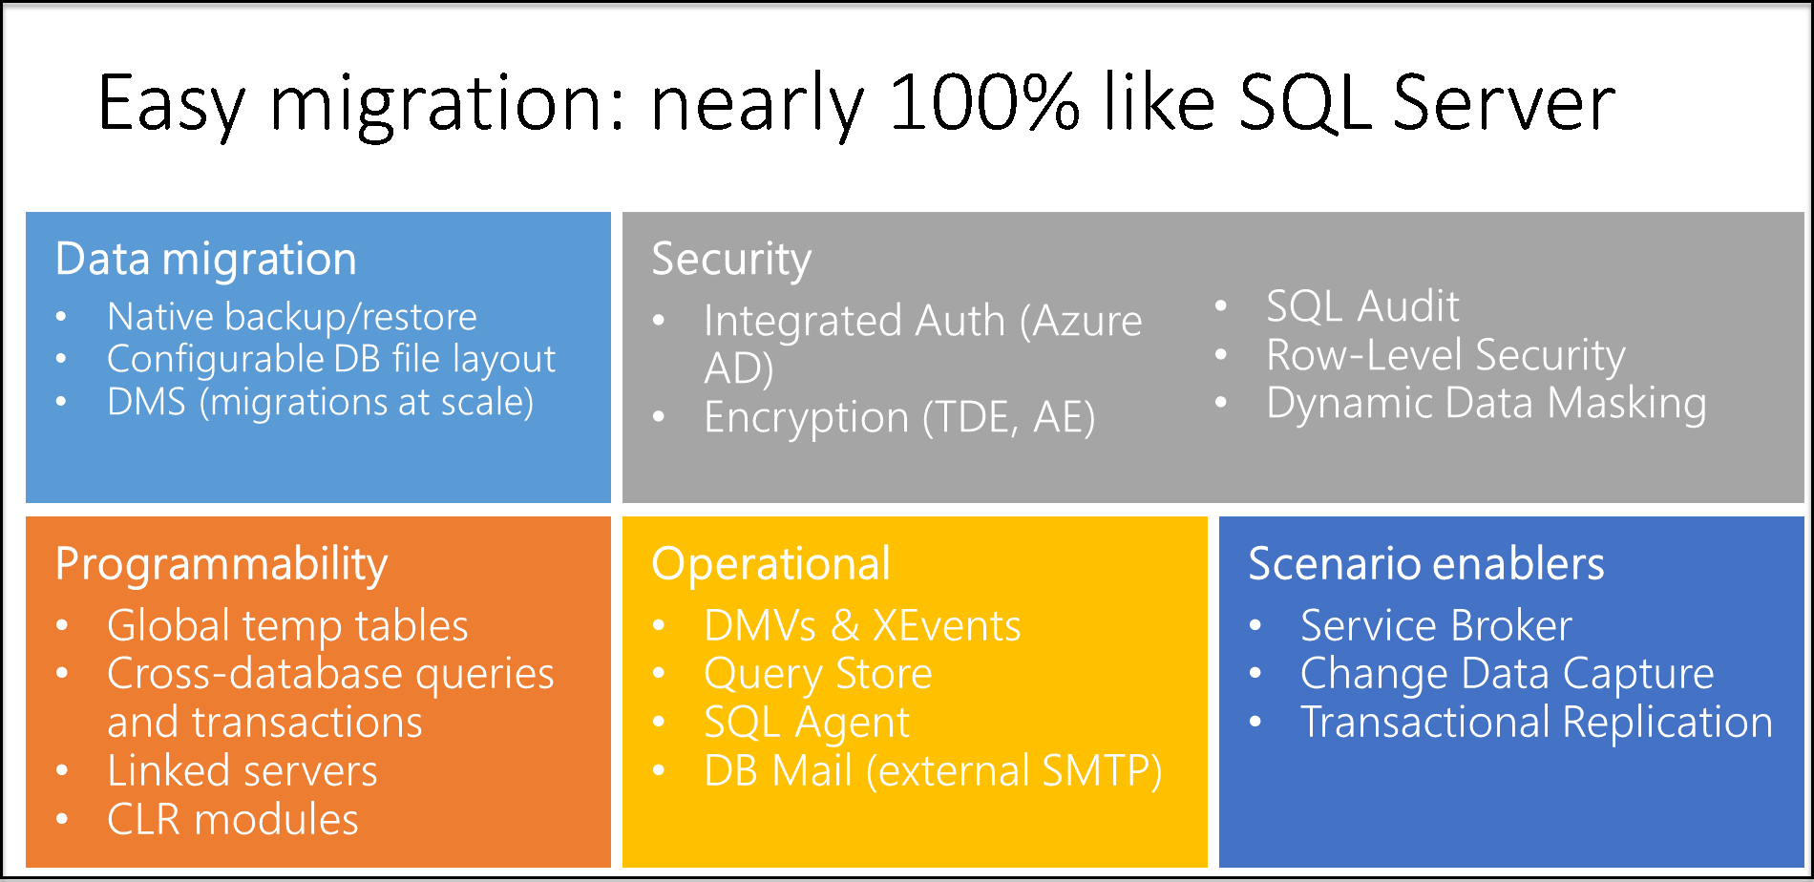
Features

Slide 19
Features
BACKUP (TO URL)
BULK INSERT (z Azure Blob)
Certificates
Collation (*)
CLR (*)
Credentials (Key Vault and SAS)
Cross DB queries (same instance)
DBCC (*)
Extended events (*)
FTS (*)
Linked Server (*)
OPENQUERY (*)
OPENDATASOURCE (*)
RESTORE (FROM URL)
Service Broker (***)
Timezone choice (*)
Trace flags (*)
Transactional replication (*)

Slide 20
Features – te nie są wspierane
Attach a database
Database mirroring
Database snapshots
Event notifications
Extended stored procs
Filestream
Linked servers (from files)
Minimal logging in BULK INSERT
Windows clustering

Slide 21
Features – co byśmy chcieli
TOP 3 nice to have
More CPU / storage choices
Pause
Faster deployment type

Slide 22
Limity

Slide 23
Limity
CPU: 4-80 (64) vCores – (4,8,16,24,32,60,64,80)
RAM: 5.1GB (13.6 GB) na vCore – potrzebujesz pamięci – dodaj vCores
InMemory OLTP (BC) – 0.8->1.5GB (2.2-4.5GB) na vCore

Slide 24
Limity
Storage: Do 16TB (BC 4TB), ale dla 4 vCores jest 2TB, 8TB dla 8 vCores, potem 16TB
Tempdb – 24 GB na vCore (GP)
Log throughput: 3 MB/s/vCore, 22-65MB/s per database
Data:
File size | >=0 and <=128 GiB | >128 and <= 512 GiB | >0.5 and <=1 TiB | >1 and <=2 TiB | >2 and <=4 TiB | >4 and <=8 TiB
IOPS per file | 500 | 2300 | 5000 | 7500 | 7500 | 12,500
Throughput per file | 100 MiB/s | 150 MiB/s | 200 MiB/s | 250 MiB/s | 250 MiB/s | 250 MiB/s

Slide 25
Scenariusze

Slide 26
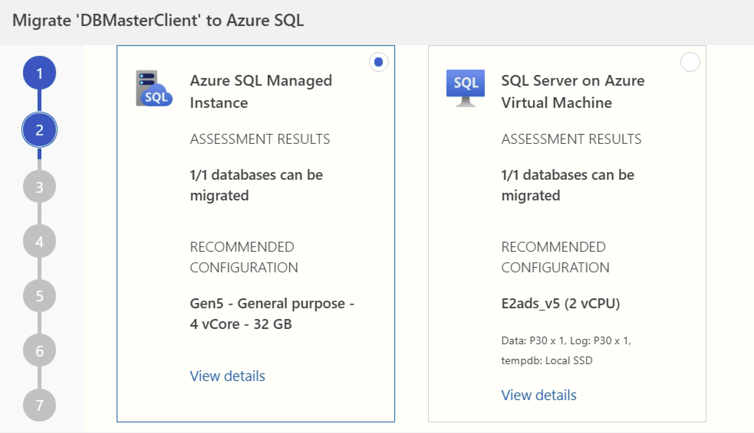
Azure Data Studio – migration assesment

Slide 27
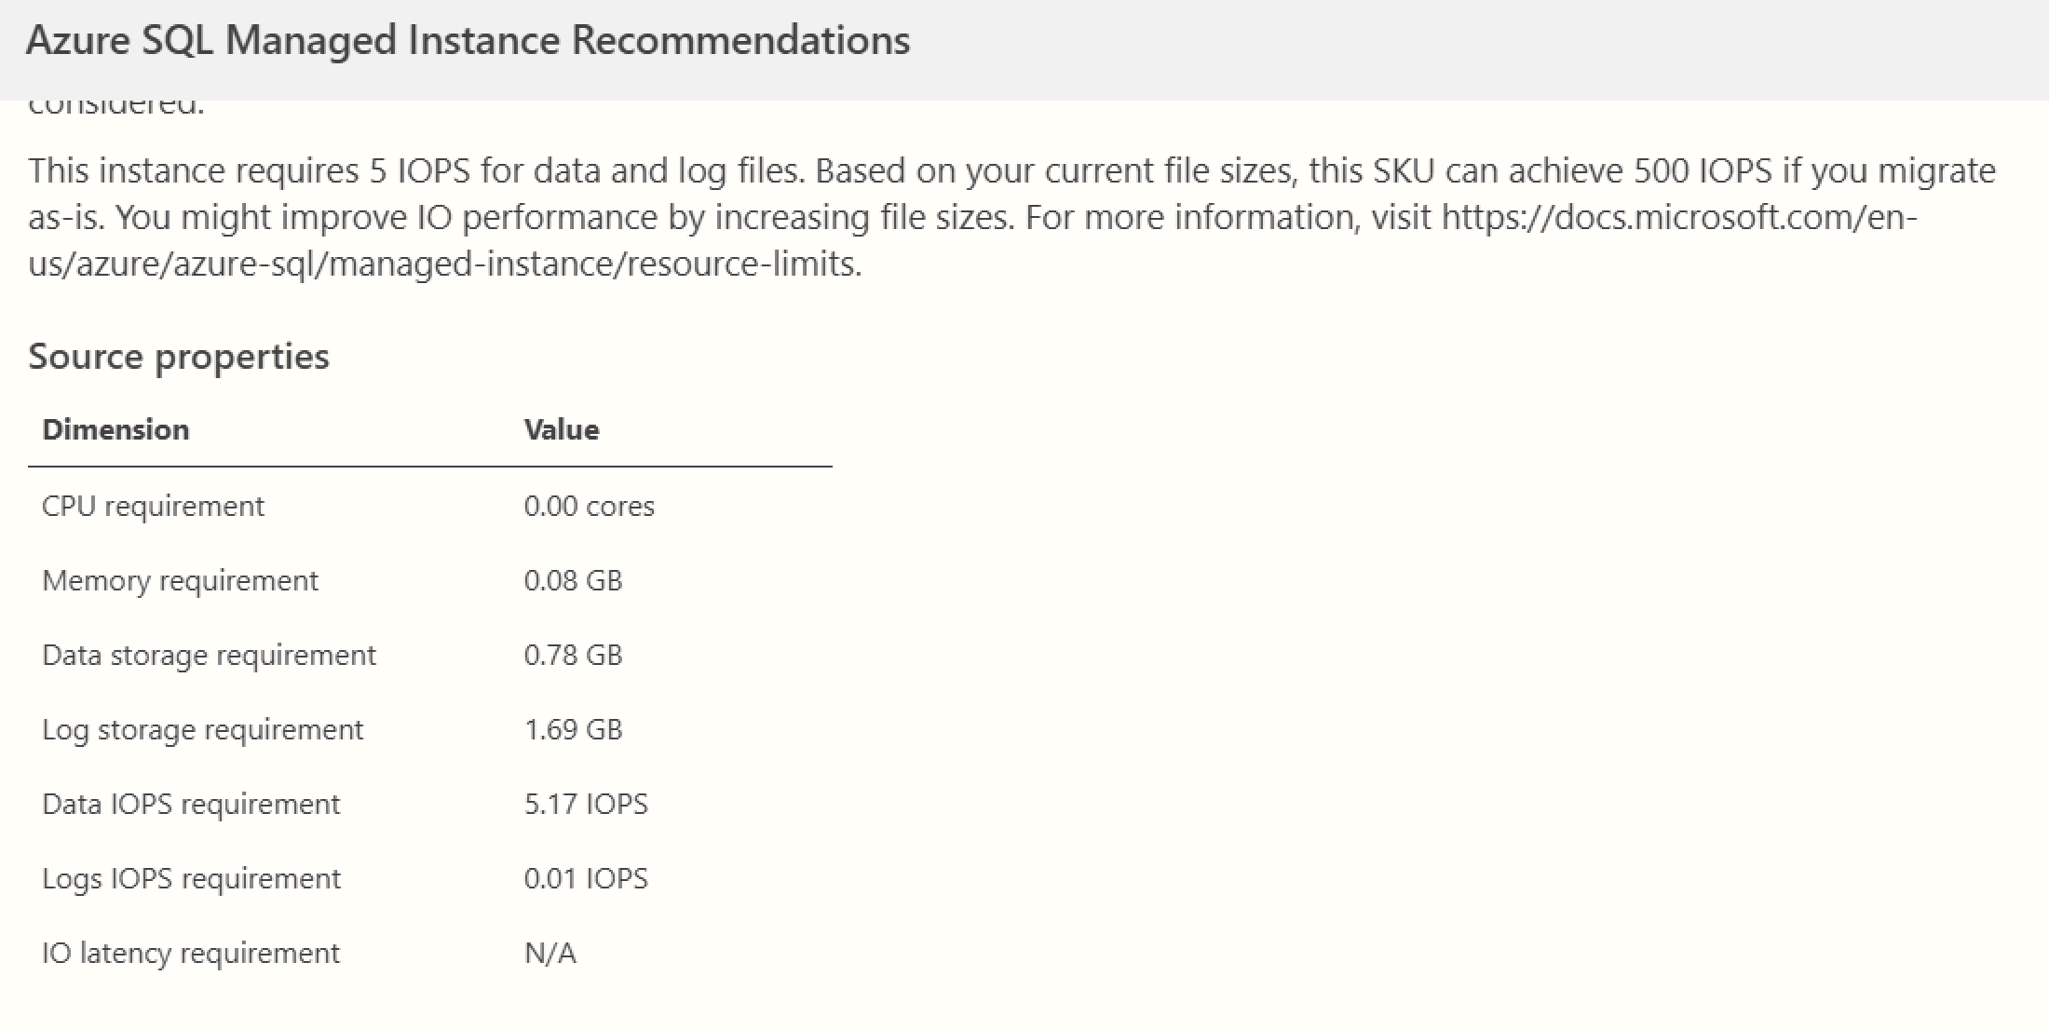
Azure Data Studio – migration assesment

Slide 28
Konfiguracja i administracja

Slide 29
Konfiguracja usługi
Portal Azure
Azure CLI
PowerShell – pełna konfiguracja

Slide 30
Administracja
DBCC
REPAIR_ALLOW_DATA_LOSS
REPAIR_FAST
Cannot be used – requires single user mode
Session level trace flags cannot be used
Corruption handled by Azure Support Team

Slide 31
Administracja
Less work
OS / RDBMS patching
Dynamic instance resizing and configuration
Backup
Database replication

Slide 32
Administracja
Cluster
Creation – 5-6h
Resizing – 2.5h
Deletion – 2h
Cancel
Instance creation
Storage scaling up / down (Business critical)
vCores scaling up/down
Instance service tier change (GP <-> BC)

Slide 33
Wydajność

Slide 34
Wydajność
Should be as regular SQL Server on VM
Automatic tuning for SQL Managed Instance only supports FORCE LAST GOOD PLAN
Automatic plan correction

Slide 35
HA/DR

Slide 36
HA / DR
High availability is built into SQL Managed Instance and can't be controlled by users.
Statements not supported:
CREATE ENDPOINT … FOR DATABASE_MIRRORING
CREATE AVAILABILITY GROUP
ALTER AVAILABILITY GROUP
DROP AVAILABILITY GROUP
The SET HADR clause of the ALTER DATABASE statement

Slide 37
HA / DR
The auto-failover groups feature allows you to manage the replication and failover of all user databases in a managed instance to another Azure region.
It is a declarative abstraction on top of the active geo-replication feature

Slide 38
Co wypróbować

Slide 39
Co wypróbować
Maintenance window – for patching purposes
Backup redundancy – (local – geo replicated) configurable also after provisioning
Data Virtualization using ADLS to be above the 16TB limit
Access directly using T-SQL
Hybrid Service Broker – connect any SQL Server to Managed Instance

Slide 40
Co wypróbować
Data virtualization with Azure SQL Managed Instance allows you to execute T-SQL queries against data from files stored in Azure Data Lake Storage Gen2 or Azure Blob Storage, and combine it with locally stored relational data using joins.
OPENROWSET syntax – optimized for ad-hoc querying of files. Typically used to quickly explore the content and the structure of a new set of files.
External tables – optimized for repetitive querying of files using identical syntax as if data were stored locally in the database.

Slide 41
Co wypróbować
Parquet and delimited text (CSV) file formats are directly supported.
The JSON file format is indirectly supported by specifying the CSV file format where queries return every document as a separate row.
It's possible to parse rows further using JSON_VALUE and OPENJSON.

Slide 42
Co wypróbować
Transactional replication - to push changes made in an Azure SQL Managed Instance to:
A SQL Server database - on-premises or on Azure VM
A database in Azure SQL Database
An instance database in Azure SQL Managed Instance

Slide 43
Co wypróbować
Managed Instance Link
connects your SQL Servers hosted anywhere to SQL Managed Instance
near real-time data replication to the cloud
offload workloads to a read-only secondary in Azure

Slide 44
Co wypróbować
Managed Instance Link
Use Azure services without migrating to the cloud
Offload read-only workloads to Azure
Migrate to Azure

Slide 45
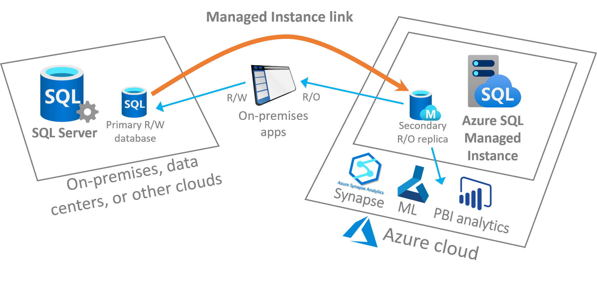

Slide 46
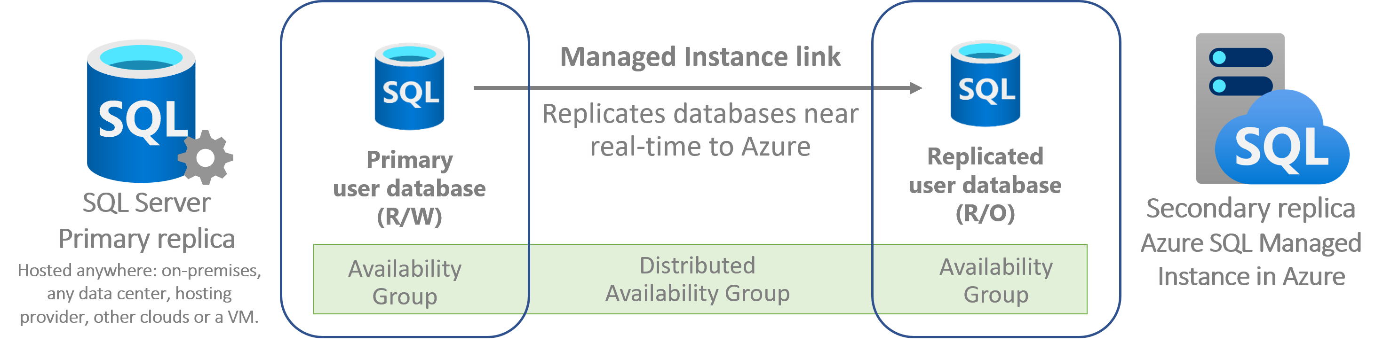
Co wypróbować
The underlying technology behind the link feature for SQL Managed Instance is distributed availability groups. The solution supports single-node systems without existing availability groups, or multiple node systems with existing availability groups.

